Slide 1

TWIQA
A DSL for developing Twitter Q&A Bots
Benedikt Langer, Lukas Schäfer, David Kleindiek

Slide 2
Table of Contents
Introduction
Project structure
Metamodel
DSL design
Game verification
Code implementation
Demonstration
Limitations, improvements, challenges

Slide 3
Twitter Q&A games
User follows bot
Bot sends challenges
User provides answers
Bot checks answers
Given locations
Time limits / Attempts
Set of answers
Set of hints
Reward → competitive

Slide 4
Developing stages
Design a Metamodel
Develop a textual DSL
Implement the actual game → Twitter API
Check games using petrinets

Slide 5
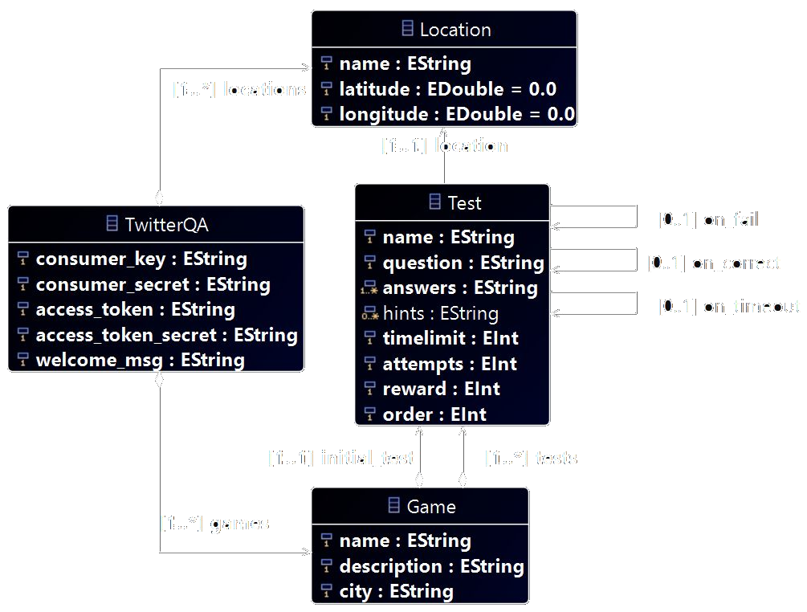
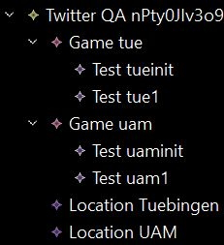
Metamodel
Bot parameters
Defines gamestructure

Slide 6
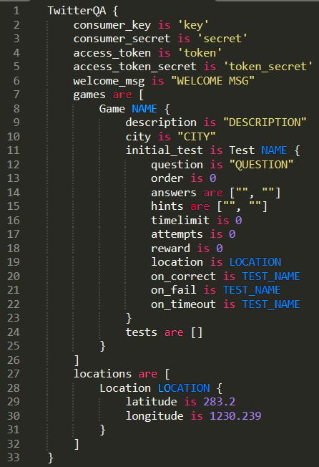
DSL: .twiqa
X-Text
Natural design
Intuitive
Brackets for structure
Convert to .xmi for later use

Slide 7
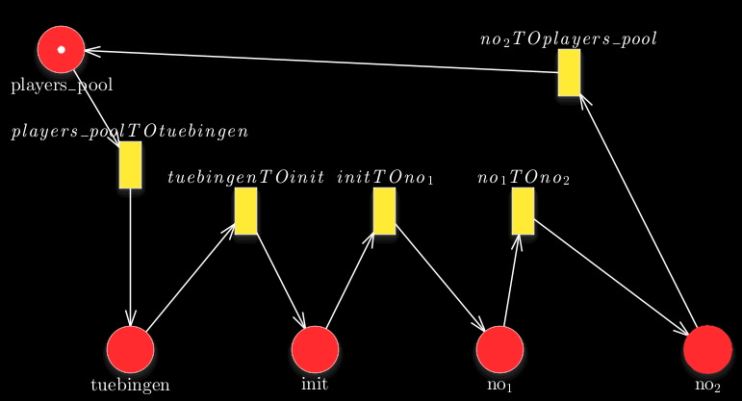
Petrinets
Game traversability
Average game time
Custom parser
Convert xml structure
GreatSPN

Slide 8
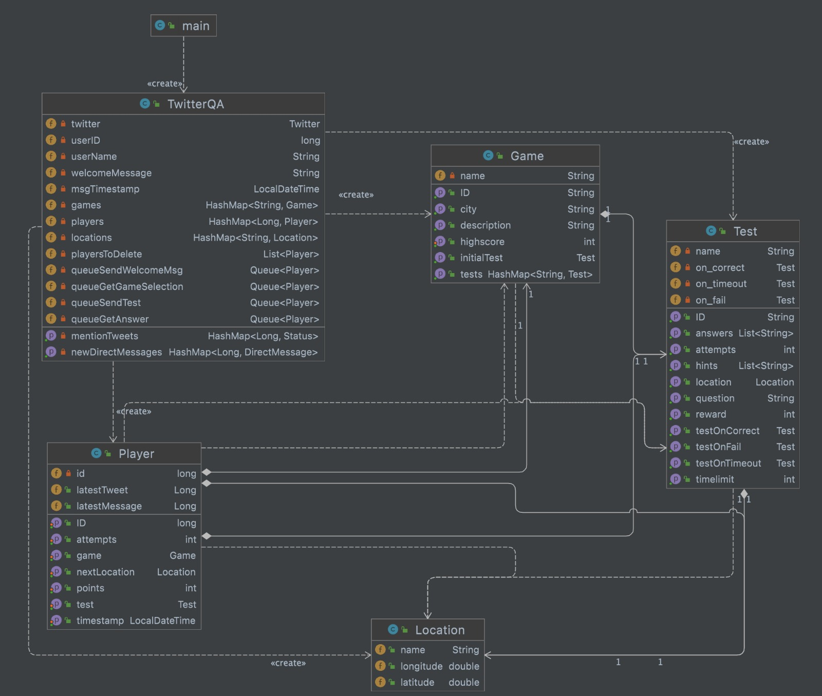
Java classes
Added player class
Game state information

Slide 9
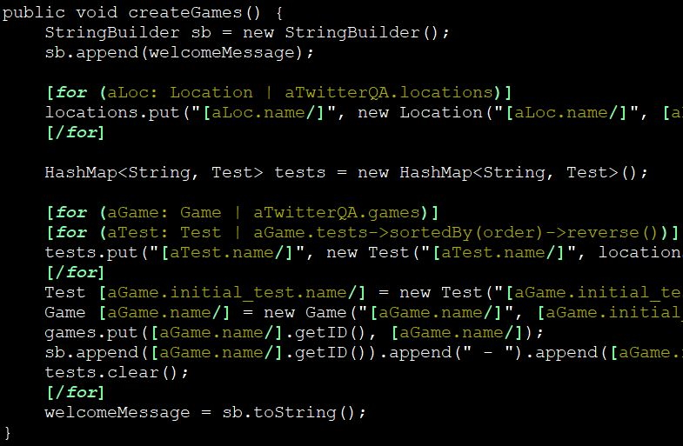
Implementation
Java with Twitter4j
Controls account
Event handler using queues
Dynamic function ‘createGames’
Game loop
SendWelcomeMsg
GetGameSelection
SendTest
GetAnswer

Slide 10
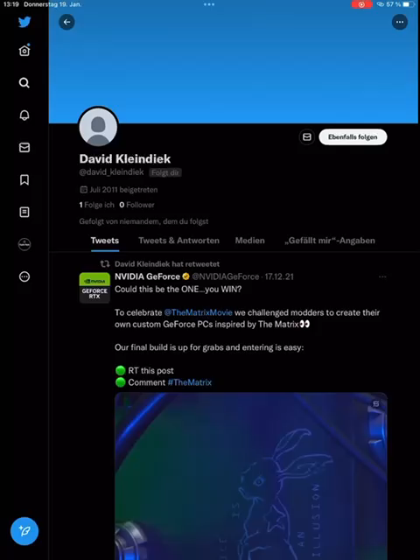
Gameflow

Slide 11
Limitations and improvements
Updates every minute → API limitation
Friendship required for private accounts
‘;’ required in answer
Location not accurate
More bot commands
Require image at location
Calculate avg gametime

Slide 12
Challenges
Collaboration problems with Eclipse
Restructuring of model is complex
Insufficient API documentation
But we did it!

Slide 13
Questions?
https://github.com/stedavkle/twitter-q-a

